Slide 1
超越学科界限的认知基础 Transdisciplinary Cognitive Foundation
Safety
Nothing
bad happens
Liveness
Some
Good Things
Must Happen
Correctness
Smart Cities: The Embodiment of Collective Consciousness Week 09
Ben Koo
November 9, 2020

Slide 2

Logic Model
Logic Model
Output: Conceptualizing cities as the embodiment of a Transdisciplinary Cognitive Foundation
Process: Story telling and Discussion
Input:
Definitions of Technical terms
Prior knowledge about Cybernetics.
Think about public policies in cognitive terms
Students’ personal projects
Context: Students have a basic vocabulary regarding NsM, Recursion, Lattice/Poset, and Monad
Goal: Show TDCF can be applied to large-scale applications, such as designing and operating smart cities
Criteria:
City formation history
AWS and Smart Cities: Bezos's infamous note
The city-scale embodiment of Cognitive activities.
A well-defined set of Actions and iterative Branching Strategies
A Roadmap of composable activities
Sequencing and timing conditions
Explicitly state dependencies and resource requirements
Boundary Conditions: Students should be familiar with the term: Cybernetics and Kubernetes

Slide 3


Glossary
Cybernetics: A scientific foundation that cut across disciplines
Kubernetes: The Greek Spelling of Cybernetics, meaning pilot
Governor: The Latin corruption of Kubernetes, according to Wiener
Software Products
Kubernetes: is also the name of an Open Sourced platform for managing containerized workloads and services, that facilitates both declarative configuration and automation. (see website) Originally created by Google.
Container Technology: A container is a standard unit of software that packages up code and all its dependencies so the application runs quickly and reliably from one computing environment to another.
Docker container image: a standalone, executable package of software.

Slide 4
Outline
Smart City(SC) = Reflection of Collective Consciousness
Cities driven by Data (Dubai, Singapore, Hangzhou)
Key Personalities that drives SC Technologies
A framework of Collective Consciousness: CICD/DevOps
Who’s your city? How’s your data shared and processed?

Slide 5
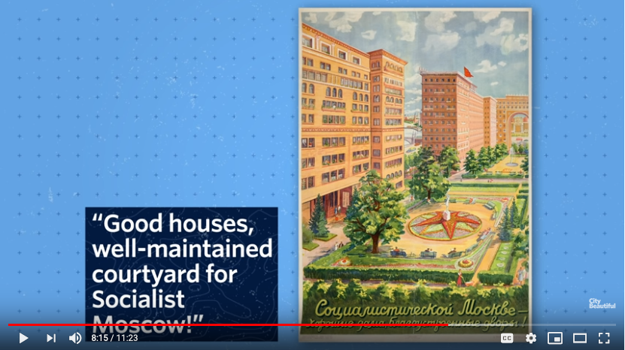

How did urban planners design Soviet cities?
All icons or images can be clicked.
They link to relevant website or videos.

Slide 6
History of Smart City?
1974
2010
2013
2019
2015
2015
2018
Genesis
Los Angeles created the first urban big data project: ”A cluster Analysis of Los Angeles” report.
Japanese government named Yokohama as a smart city demonstration project.
China launched first batch of pilot smart cities, comprising 90 cities, districts and towns.
China announced third batch of 84 cities, comprising 277 in all
Singapore won Smart City of 2018 award at the Smart City Expo World Congress
G20 nations picked World Economic Forum as secretariat for a G20 Global Smart Cities.
India's Prime Minister Narendra Modi Launched :Smart Cities Mission" for 100 Indian Cities.
Data Source: https://www.verdict.co.uk/smart-cities-timeline/

Slide 7
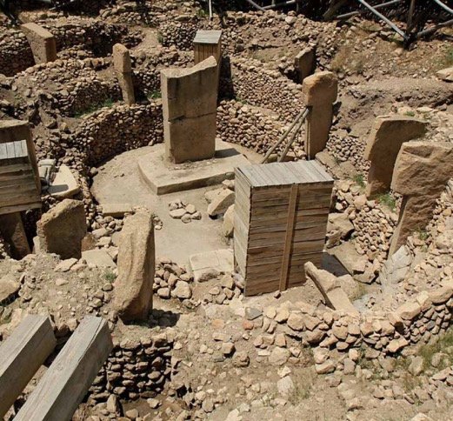
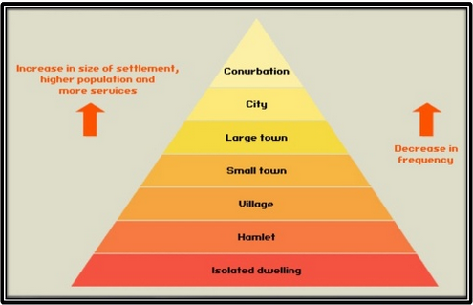
What make up a city?
Basic Concept of Human Settlement by Martin Adlaon Arnaiz Jr.
A city is a large human settlement.
- Wikipedia, last accessed July 20, 2020

Slide 8
What make Cities Smart?

Slide 9
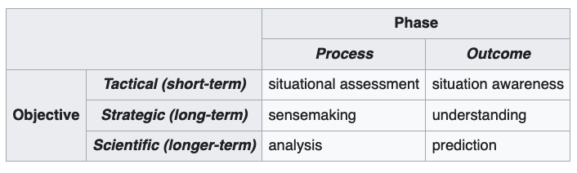
The Collective Consciousness makes a City Smart
Can a smart city be aware of its residents' needs at the appropriate occasions.
Notes:
What is the difference between innocence and ignorance?
I don’t know and I don’t care!

Slide 10
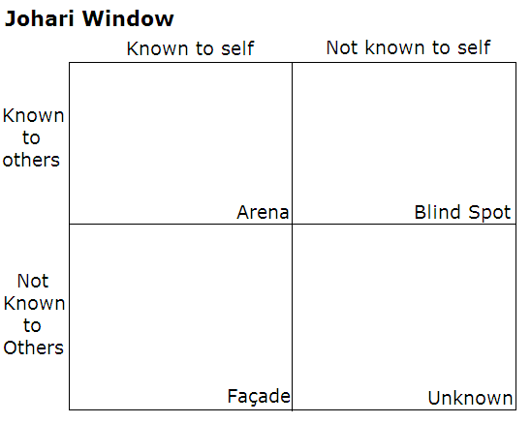
The Johari Window: how to classify knowledge
https://en.wikipedia.org/wiki/Johari_window
Notes:
What is the difference between innocence and ignorance?
I don’t know and I don’t care!

Slide 11
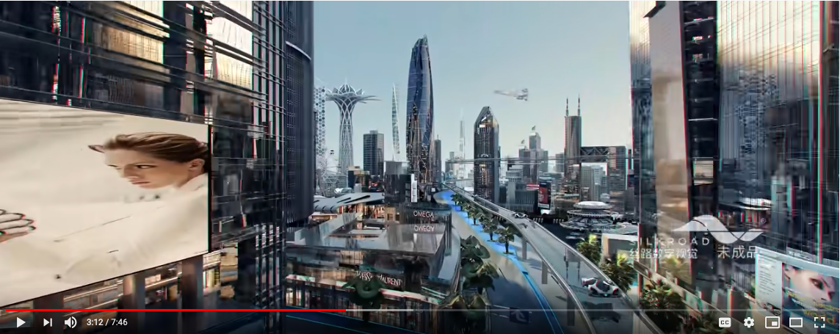
Some Features of Smart Cities
Communication & Computation
Energy Production & Distribution
People and Material Transportation
Emergency Response and Cybersecurity
Economic Value Creation
Image and video: The Future City-virtual tour animation by Silkroad Visual Technology Company

Slide 12
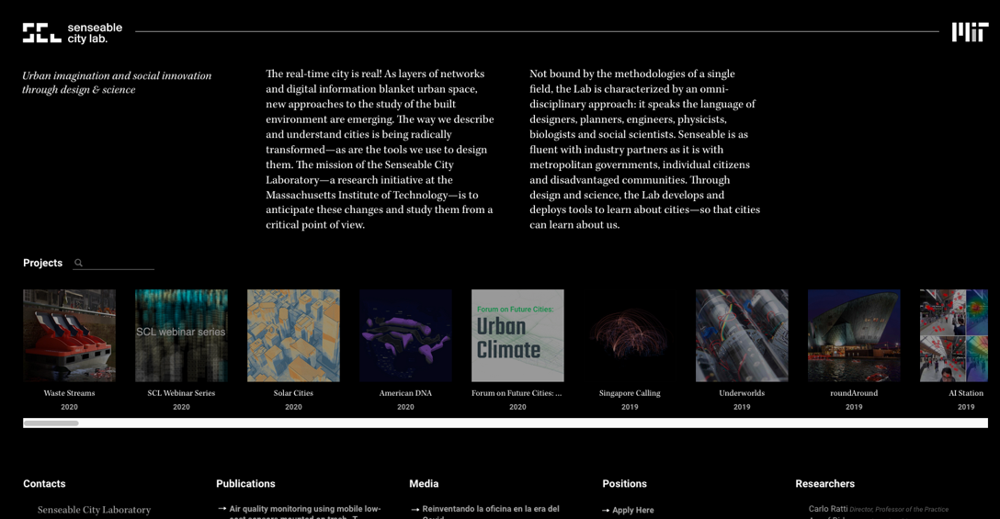
Sensible City Lab at MIT
Prof. Carlo Ratti of MIT Sensible City

Slide 13

Become cognizant is all about interpreting Data
Prof. Sarah Williams of MIT Urban Planning Department

Slide 14
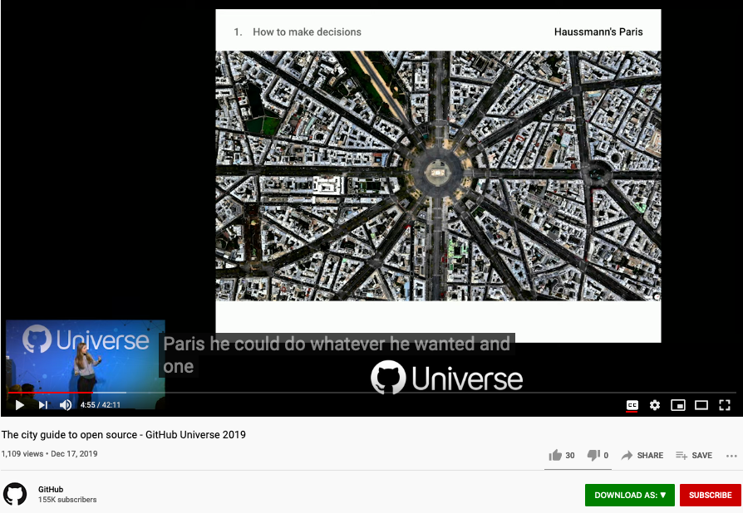
City and Open Source Community
The City Guide to Open Source
Devon Zuegel, Product Manager of the Open Source Economy Team at GitHub

Slide 15
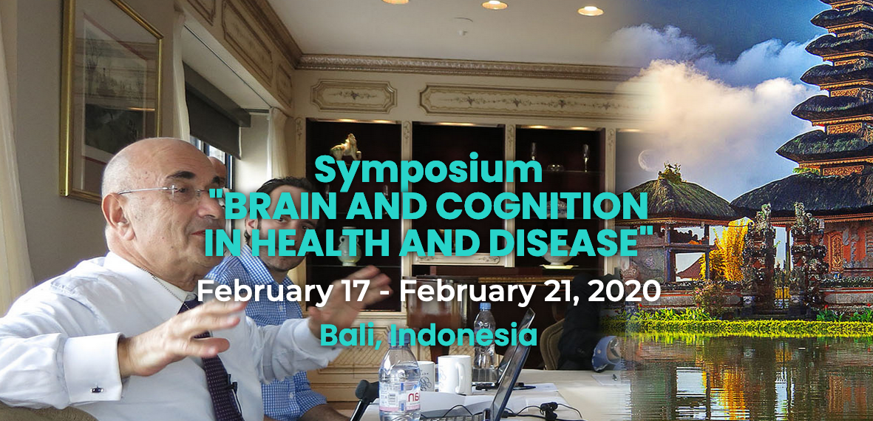
Prof. Elkhonon Goldberg and the Happy City Project

Slide 16


What does Happiness Mean on a Collective Scale?
Halted Construction
New Construction
Aging
Abandoned

Slide 17
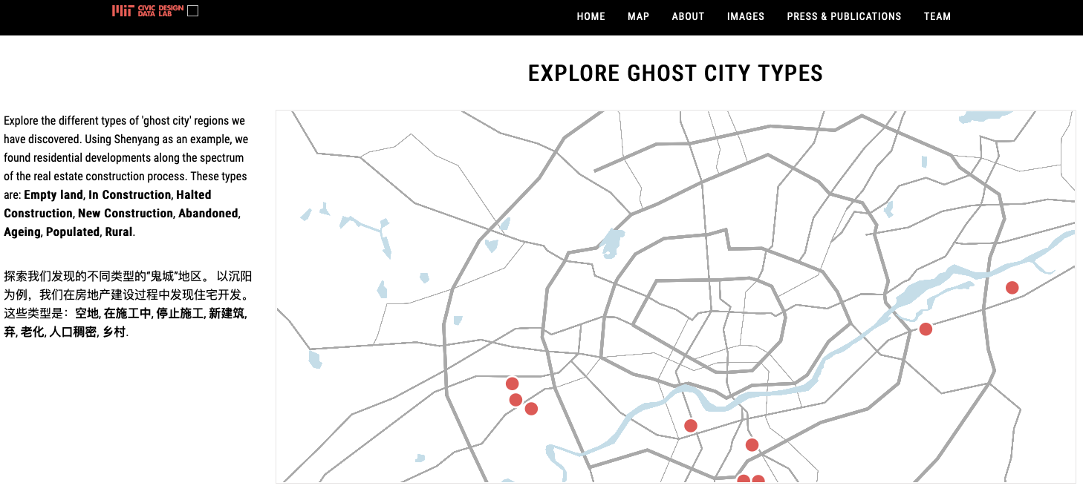
Study Happiness/Consciousness on City Level
Halted Construction
New Construction
Aging
Abandoned

Slide 18

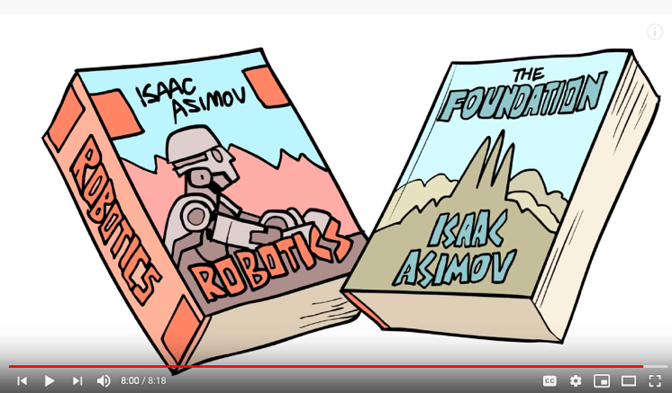

Psychohistory and Cyber-Physical Unity

Slide 19
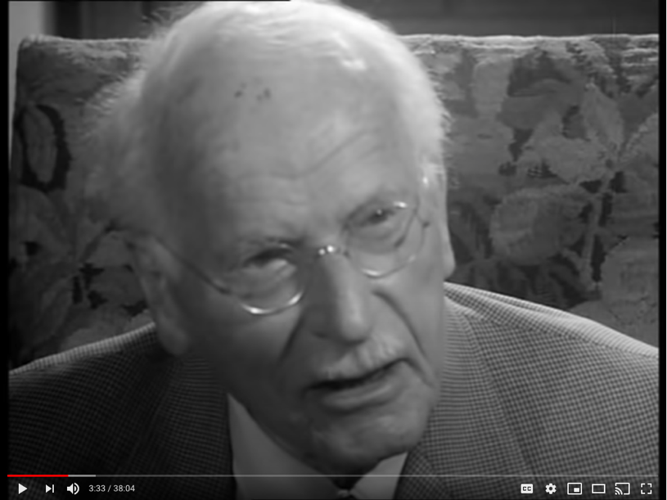
Smartness of The Living Cities
City is the embodiment of massive collective consciousness!
Face To Face | Carl Gustav Jung (1959) HQ

Slide 20
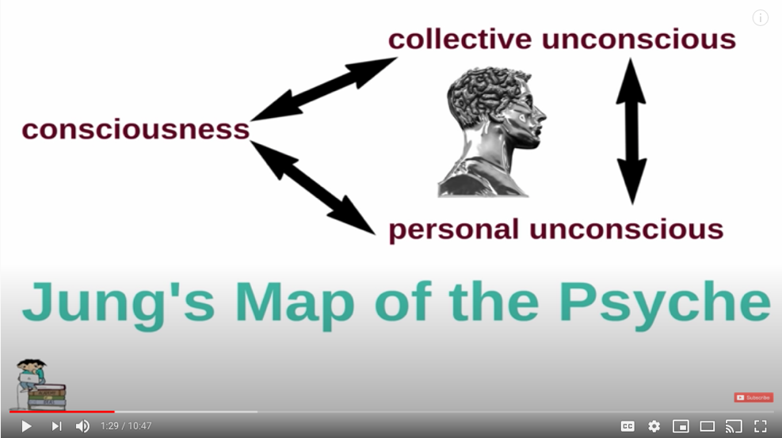
Why would you care about a City’s Consciousness?
Academy of Ideas: Introduction to Carl Jung - The Psyche, Archetypes and the Collective Unconscious

Slide 21
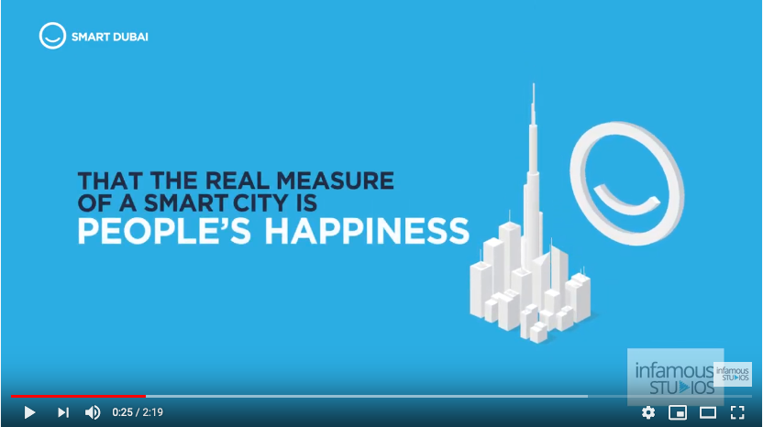
Best Online Services: Dubai on the Web

Slide 22
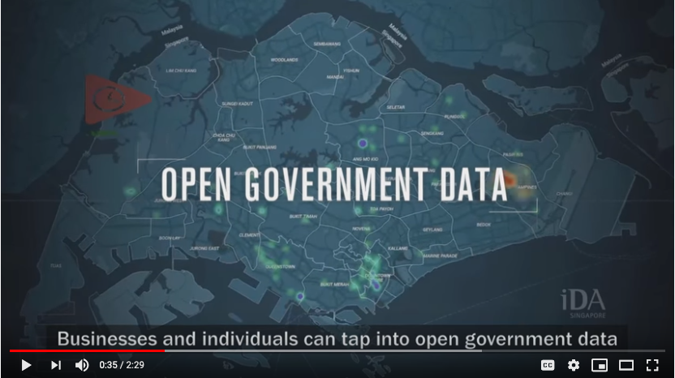
Singapore on the Web

Slide 23
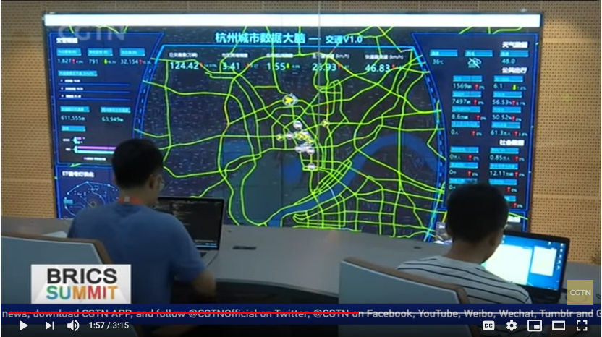
Hangzhou on the Web

Slide 24
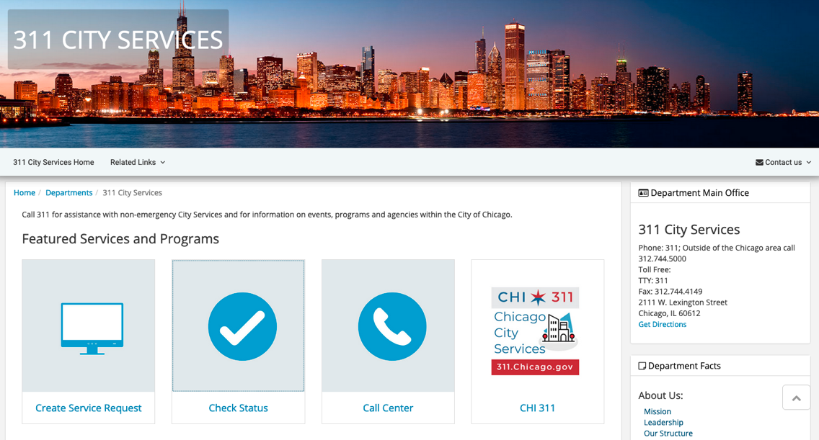
Best Online Services: Chicago on the Web

Slide 25
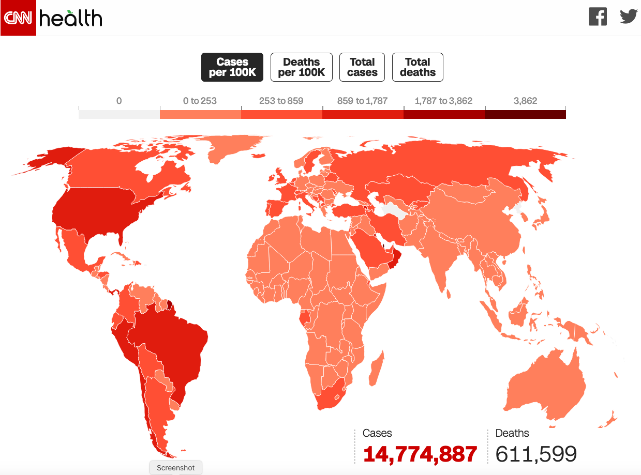
Observability at Scale?

Slide 26
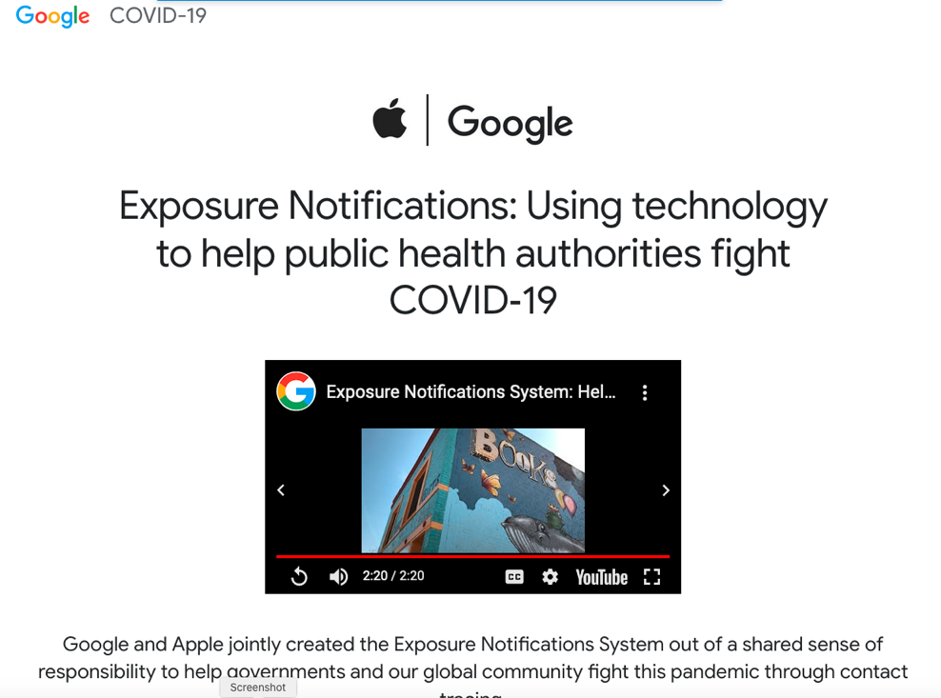
GAEN: Existing Operational Practice
No one can afford to embed Security on all scales of operational activities, from conceptualization, design, implementation, deployment, to decommission, unless the whole system is designed and implemented with a unified security model.

Slide 27
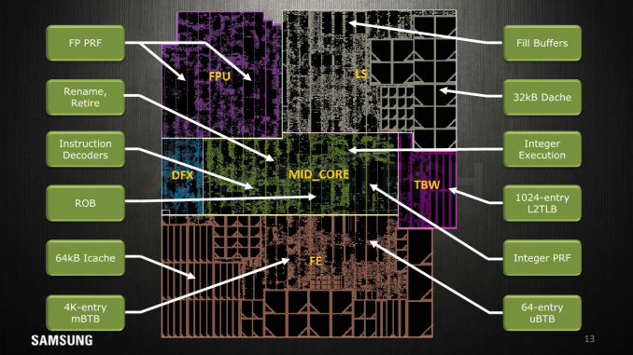
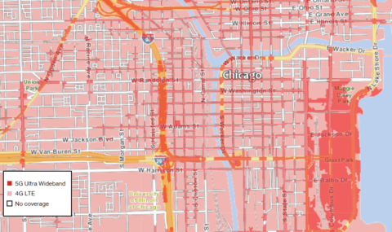
From Chips to Cities
5nm Chips and 5G Infrastructures

Slide 28
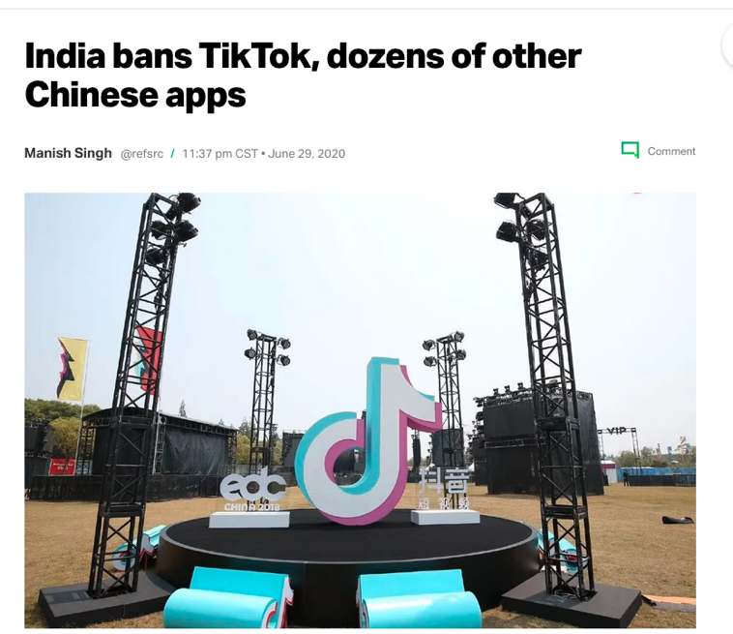
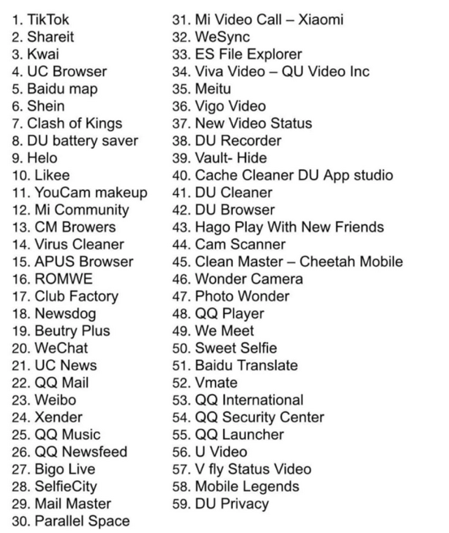
Soft Power

Slide 29
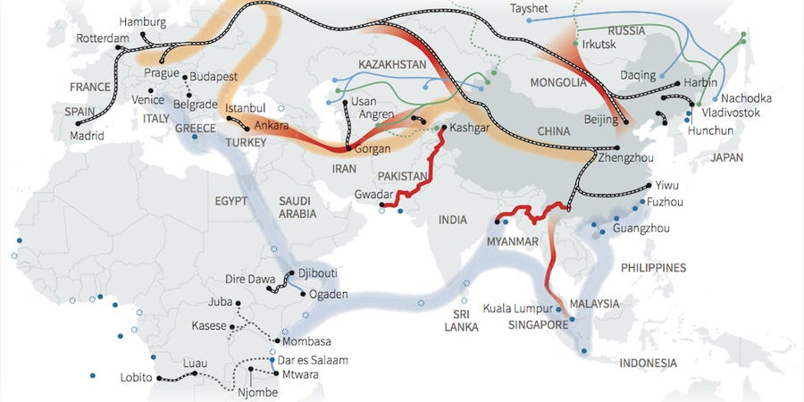
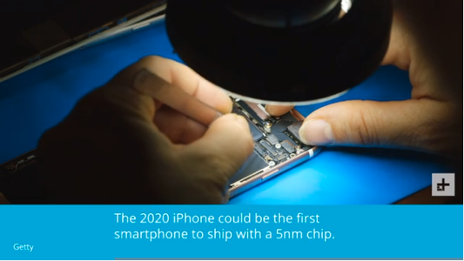

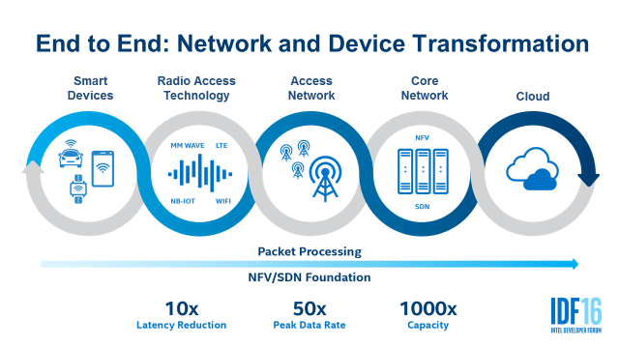
Hard Power

Slide 30
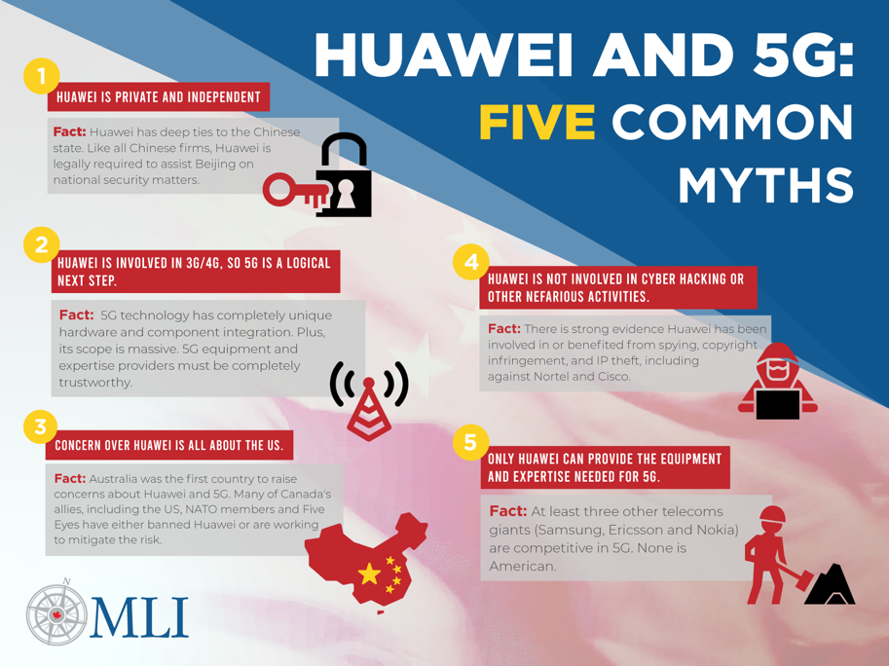
International Contention on 5G

Slide 31
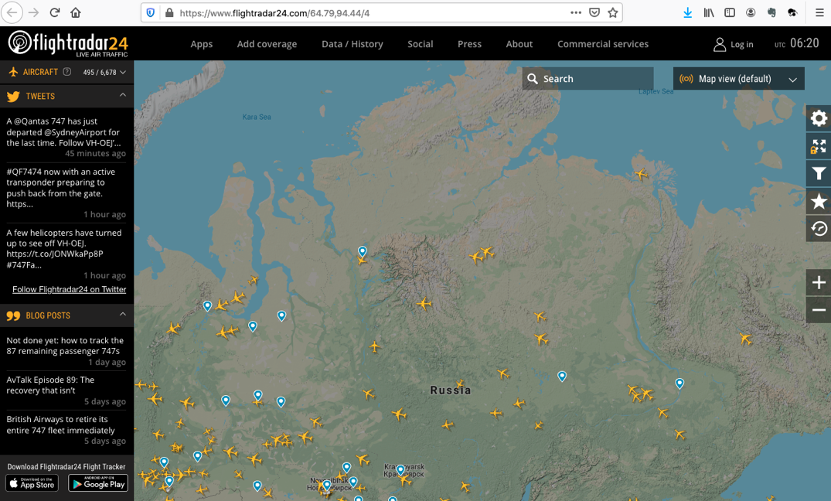
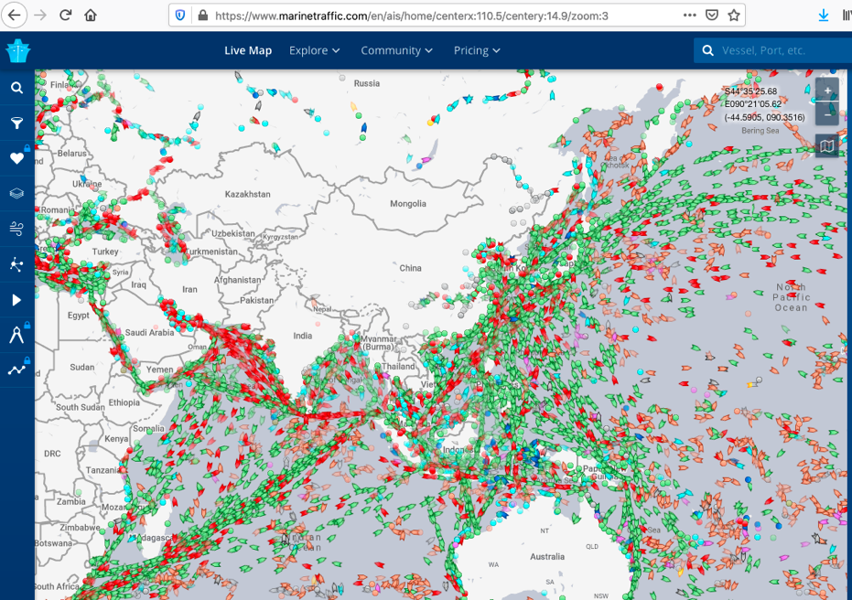
Get access to Public Data Now!
https://www.flightradar24.com/
https://www.marinetraffic.com/

Slide 32
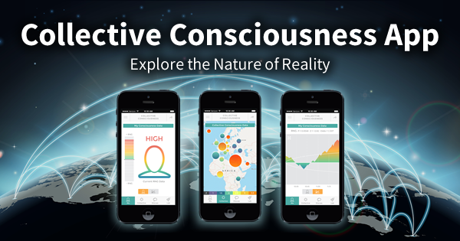
Personalities that Represent Cities of the Future
http://www.global-mind.org/, https://noetic.org/

Slide 33

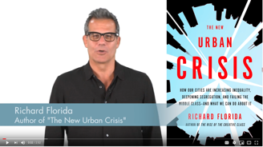
Richard Florida’s 3T Model
Technologies: local industries
Talents: communities of talented people
Tolerance: policy that encourages diversity

Slide 34
A Smart World Driven by Physically Meaningful Data
Image credits: http://verses.io

Slide 35
Situational Awareness at many levels
The Collective Consciousness should be able to act on all three scales of situations.

Slide 36
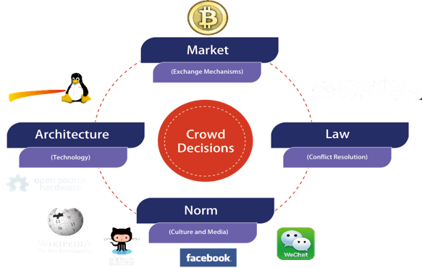

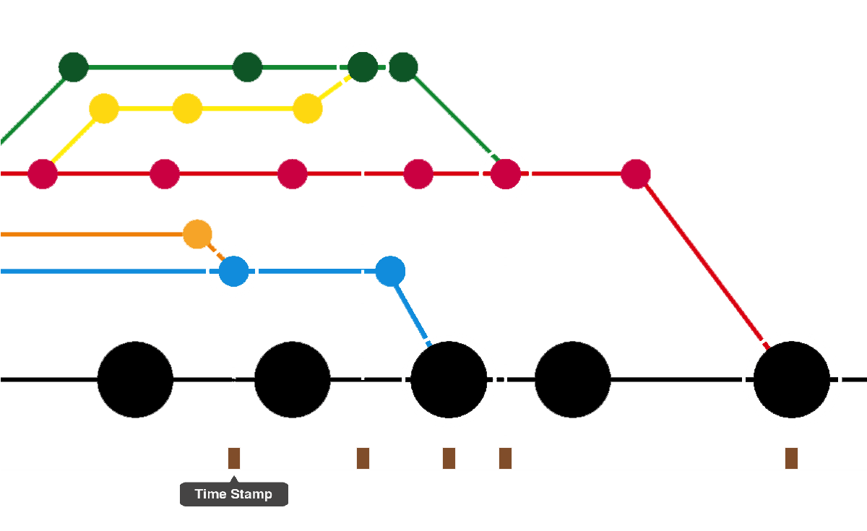

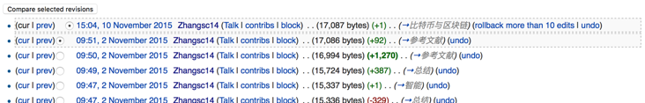

Spacetime properties of Consciousness
Macroscopic:
Four Motivating Forces
Mesoscopic：
Recombination of Resources
Concept Generation
Resource Planning
Coordi-nation
Engineering Refinement
Concept Deployment
Microscopic：
Process Data and Summative Result

Slide 37

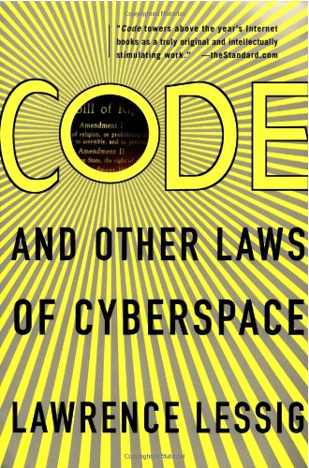
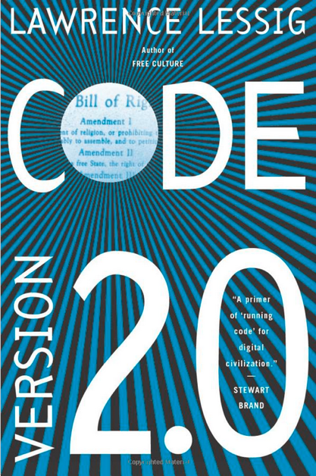
Code is Law

Slide 38
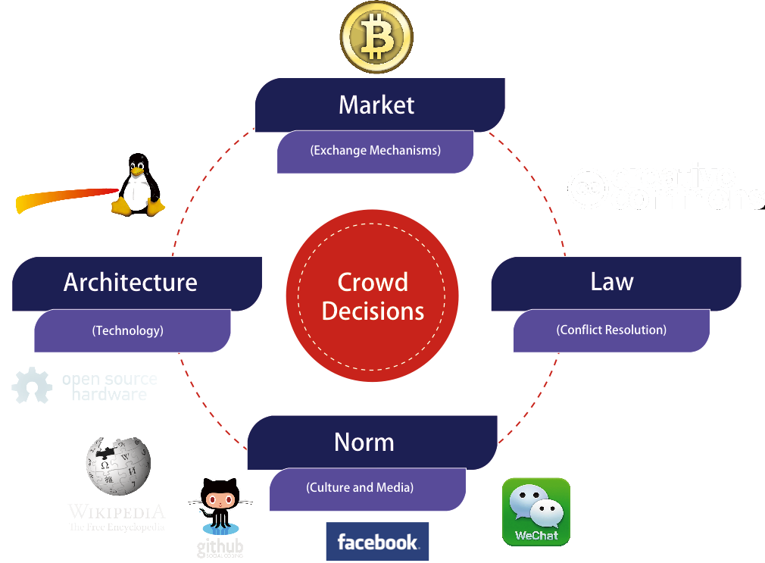
Spacetime Representations for a Crowd
Far
Space
near
before Time after

Slide 39
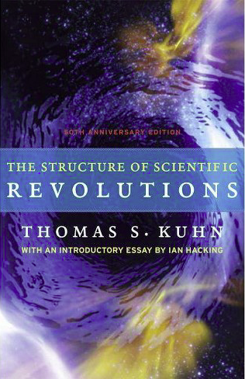
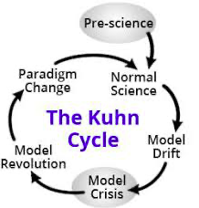
All events are Emerging Events
Normal Operations
Drifting Norms
Operational Crisis
User Revolution
Version Upgrade
Emerging cases or
systematic attacks
Self-Actualization
Esteem
Love and Belonging
Safety and Security
Physiological needs
Maslow’s Hierarchy of Needs

Slide 40

DevOps Goals for Governance
Notes:
1. 對稱性是底層的不變性
2. 在Cyberspace上，數據、操作數據的方式、操作數據的基礎架構，是資產的根本
3. 邏輯模型是凝聚群體意識的有效框架
4. Devops 能夠高效實現不同規模的Logic Model, 藉由（不同層次）數據可視與可控

Slide 41




Cyber-Physical Space Integration
Public Domain Data
Smart Contract Data
Private
Data
Notes:
1. 對稱性是底層的不變性
2. 在Cyberspace上，數據、操作數據的方式、操作數據的基礎架構，是資產的根本
3. 邏輯模型是凝聚群體意識的有效框架
4. Devops 能夠高效實現不同規模的Logic Model, 藉由（不同層次）數據可視與可控

Slide 42

Three Scales of Time
Mesoscopic：
Localized Adjustments
Time Stamp
Macroscopic:
Five Stages of Evolution
Normal Science
Model
Drift
Model Crisis
Model Revolution
Paradigm Change
Microscopic：
Process Data and Summative Result
Time Stamp

Slide 43
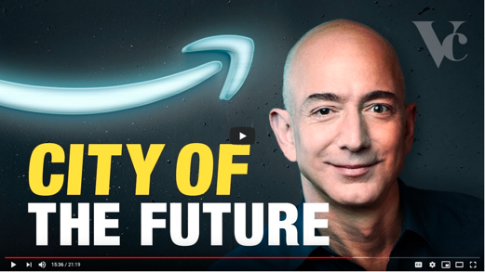

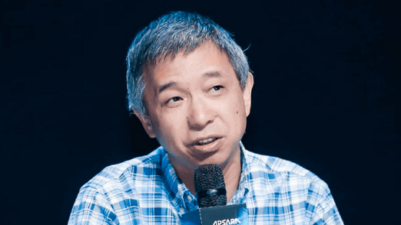
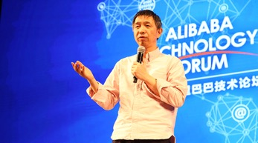
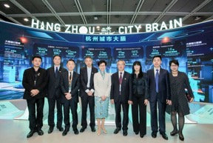



Leading Thinkers of Futuristic Cities

Slide 44
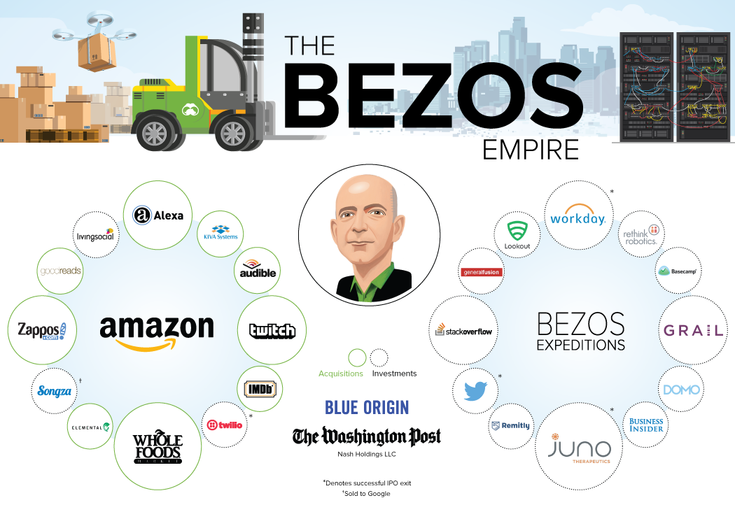
The man that is running the show…

Slide 45
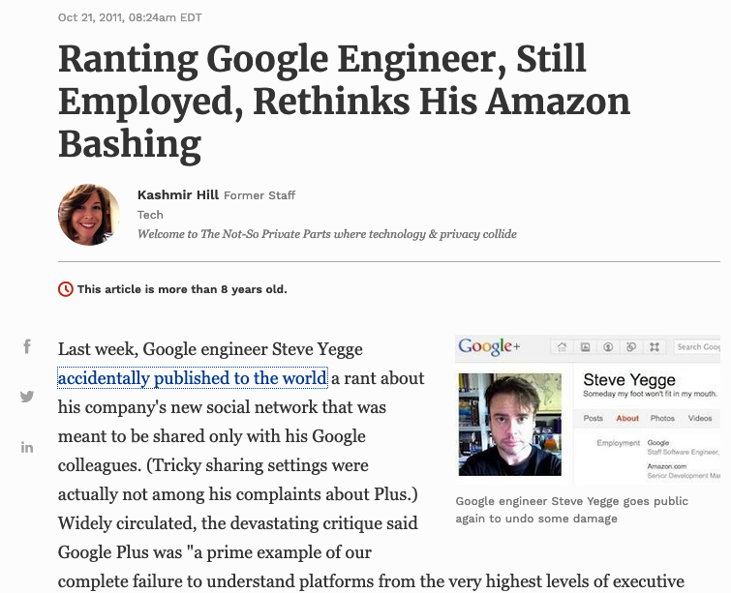
Steven Yegge's Google Platform Rant

Slide 46

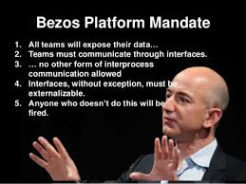
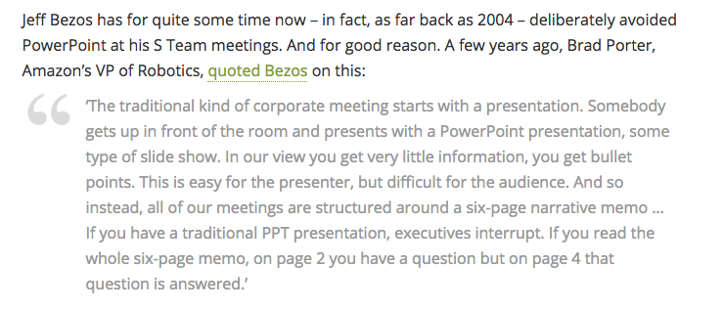
Jeff Bezos and NPPP
No Power Point Policy

Slide 47
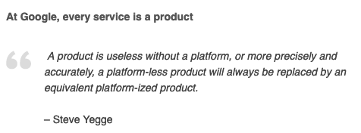
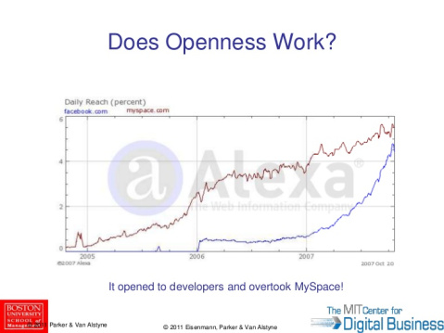
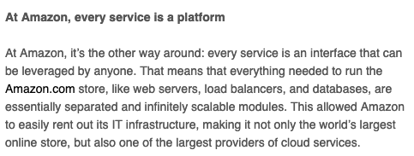
Bezos’s NPPP eventually created DevOps

Slide 48
The Universal Structure in 𝜆-Calculus Form
Expression := Contextualized Data (* Known interpretation results, no computation *)
| Goal_Exp Criteria_Exp (* Timeless and Time-based expressions *)
| 𝜆 Input Output_Exp(Input) (* A Computing Process *)
| ( Exception_Handling ) (* Stated boundary conditions/Exceptions *)
This set of rules can be used recursively to generate an infinite amount of expressions.
What
Contextualized data
Goal Expr
Criteria Expr
Why
𝜆
Input
Output Spec
How
( )
Exception Handling

Slide 49

Amazon Lambda offers Function as a Service (FaaS)

Slide 50

Serverless, Mobile, and Internet of Things (IoT)
Using IoT with Serverless to Tackle Global Issues
By Sarjeel Yusuf, on Medium (URL)

Slide 51

Serverless Computing in Abstractions
Using IoT with Serverless to Tackle Global Issues
By Sarjeel Yusuf, on Medium (URL)

Slide 52
Time Stamped Data Preserve Event Ordering Information
Normal Science
Model
Drift
Model Crisis
Model Revolution
Paradigm Change
Time Stamp
Time Stamp
Time Stamp
Time Stamp

Slide 53

What is CICD and DevOps? Continuous Integration, Continuous Delivery/Deployment
Image courtesy: Peter Change on Hackernoon

Slide 54

Technology Integration Process
Image courtesy: Learn How to Set Up a CI/CD Pipeline From Scratch on DevOps Zone

Slide 55
Iteratively Fixing Security Problems
Technology Integration
Technology
Society
Security
Technology
Security
Society
Technology Isolation
Modified from Figure 1-1 and 1-2 of Agile Application Security: Enabling Security in a Continuous Deliver Pipeline,
by Laura Bell, Michael Brunton-Spall, Rich Smith & Jim Bird, O’Reilly Media, 2017

Slide 56



The Version Control, Built, Test, Stage, Deploy are Conducted by Human Instructions
Image courtesy: Learn How to Set Up a CI/CD Pipeline From Scratch on DevOps Zone

Slide 57
A compositional view of system correctness
Liveness
Safety
Correctness
The Theoretical Definition of System Correctness
Correctness = Liveness ∧ Safety
Liveness: Something good eventually happens
Safety: Nothing bad ever happens

Slide 58

The Commit-Built-Test-Stage-Deploy are Fully Automated
Image courtesy: Learn How to Set Up a CI/CD Pipeline From Scratch from DevOps Zone

Slide 59
Continuously Adjust the Correctness Area
Liveness
Safety
Correctness
The Inremental Change Approach promoted by DevOps/CICD practitioners

Slide 60

Automation approximates and enables Process Continuity
Image courtesy: Learn How to Set Up a CI/CD Pipeline From Scratch from DevOps Zone

Slide 61

What is DevOps? Development and Operations
Image courtesy: Riyaz Hyder on Botmetric November 2, 2017

Slide 62

Instrumentation of DevOps
Image courtesy: PETSEBAN on NearCoding

Slide 63









City of the Future Corporate Representatives
Tencent,
Huawei,
Alibaba,
Baidu
Facebook
Apple
Google

Slide 64

Large Scale Policy Simulator

Slide 65
A Smart way to Govern Activities in Space-Time
Transform everything into Data
(Namespace Management)
Image credits: http://verses.io

Slide 66


Domain Names are Valuable Properties
DNS: Domain Name Service

Slide 67



What3Words

Slide 68

Displaying Large Spatial Data Set on as Many Devices as Possible
Website::https://smart3d.tongji.edu.cn/cn/

Slide 69

”Real” Time-based Event Sequence Authentication

Slide 70



Clockspeed of infrastructure implementation

Slide 71

Power of a Dominant Design/Protocol
“Theoretical framework: dominant category and dominant design during the industry life cycle. During the industry life cycle, the number of categories will increase before the number of firms increases. The emergence of the dominant category occurs as the number of categories begins to decrease. This point in time marks the opening of the window of opportunity for entry, whereas the emergence of the dominant design marks the closing of the window of opportunity”
Excerpt from the article:
Perfect timing? Dominant category, dominant design, and the window of opportunity for firm entry

Slide 72

The Importance of eliminating Changes: Functional Symmetry over Time

Slide 73

Blockchain, Distributed Ledger Technologies: Time is Money
https://www.investopedia.com/terms/b/blockchain.asp

Slide 74






Trust-worthiness in Governance? Balancing interests of 3 open-border communities
Three Asynchronous
Clocks in their respective
Communities
Smart Contract Execution
Traders
Miners
Coders
Version Upgrade
Production Code
Function Requests
Customer Crisis
Feature Revolution
Emerging cases or
systematic attacks
Perform Checking
receive confirmation
commit transaction

Slide 75

Smart Contract with Observable Historical Data
ISDA: International Swaps and Derivatives Association

Slide 76



Legal Algorithms: Code is Law

Slide 77


What is DevSecOps?
Sec
Dev
Ops
Image courtesy: Paladion Corporation Website https://www.paladion.net

Slide 78




Updating Name Space to across time scales
Traders/Hunters
（students/teachers）
Miners/Herders
（Administrators/Witnesses）
Coders/DNA Editors
(Artists/Creative People)
Consumers/
Distributors
Sec
Dev
Ops
Content Producers/
Product Designers
Accountants/
Notary Service Providers

Slide 79



GitOps: Git as the Single Source of Truth

Slide 80
Ricardian Contract Socially Binding Digital Twin

Slide 81

A Smarter Smart Contract

Slide 82

Executable Contract for Kubernetes
Video URL: https://youtu.be/qmDzcu5uY1I?t=122

Slide 83


Logic Model and Config File
Contextualized data
Goal Expr
Criteria Expr
𝜆
Input
Output Spec
( )
Exception Handling

Slide 84



Applying Functional Programming to solve City-scale Problems
Keynote talk at the Applied Category Theory 2020 Conference

Slide 85




Applying Functional Programming to solve Planetary-scale Problems
2009 paper on IEEE’s Systems, Man, and Cybernetics Journal

Slide 86

Abstracting all computing resources to Industrial Scale

Slide 87

IaaS: Infrastructure as a Service

Slide 88

Istio: a popular industry standard An Internet-Scaled Data Infrastructure
Data Plane
Data Plane
Control Plane
Control Plane

Slide 89
Istio: a popular industry standard An Internet-Scaled Data Infrastructure
Control Plane
Control Plane
Data Plane
Data Plane

Slide 90
Smartness in the Cloud
https://www.cncf.io/
Cloud native technologies empower organizations to build and run scalable applications in
modern, dynamic environments such as public, private, and hybrid clouds.
Containers, service meshes, microservices, immutable infrastructure,
and declarative APIs exemplify this approach.
These techniques enable loosely coupled systems that are resilient, manageable, and observable.
Combined with robust automation, they allow engineers to make high-impact changes frequently
and predictably with minimal toil.
The Cloud Native Computing Foundation seeks to drive adoption of this paradigm by
fostering and sustaining an ecosystem of open source, vendor-neutral projects.
We democratize state-of-the-art patterns to make these innovations accessible for everyone.

Slide 91

The Path to Cloud Native
Figure 2-1: Istio Up and Running, by Lee Calcote and Zack Butcher

Slide 92


LiveDesign
With Dr. John Nash in IMS 2003
Image courtesy: Prof. Gautam Dasgupta of Columbia University

Slide 93

The Question of Equity
Right to use publicly available technologies and other resources in the learning process
Right to resolve conflicts in a dynamic context in digitized space
Freedom to make decisions related to one’s personal digital assets
Freedom to express one’s opinions
Founder of Free Software Foundation, and Creator of GNU/Linux. Image credit: Wikipedia
Paraphrased from “Free Software, Free Society” by Richard Stallman

Slide 94

The Rise of Open Source Movement： A Global Infrastructure relying on Unpaid Labor

Slide 95




Participation Model and Data Agencies
New Narrative for AI/XI
Free Will at all levels and scales of society
Metrics for Success
Reclaim Rights to Digital ID
Observability/Data Immutability. Data Presentation Tech
Affordable Personal Security (OpenID/Kerberos)
Anonymous Network (Dark Net)

Slide 96

Not Information Asymmetry, but promote the Principle of Information Symmetry

Slide 97
Open and then Free
Open Source
Right to use publicly available technologies and other resources in the learning process
Right to resolve conflicts in a dynamic context in digitized space
Freedom to make decisions related to one’s personal digital assets
Freedom to express one’s opinions
Free Software
Founder of Free Software Foundation, and Creator of GNU/Linux. Image credit: Wikipedia
Paraphrased from “Free Software, Free Society” by Richard Stallman

Slide 98


Service Mesh (Istio) and Human Phsiology Checks and Balances
Data Plane
Control Plane
Data Plane
Control Plane

Slide 99

CXI: Council on Extended Intelligence

Slide 100

E-Citizenship

Slide 101







DevOps for Smart Cities

Slide 102




Using AI and DevOps to create simulated Cities
(Video: https://youtu.be/hjpHsXRp790)

Slide 103





Writing Constitutions in Class
Hyperlinks
between
Documents
Digital Asset
Backup/
Tracking/
Exchange

Slide 104



2019 International Summer Program @ Tsinghua Experience sites in Beijing and meet with people
Noitom: The World Leading Motion Capturing Company

Slide 105
2019 International Summer Program @ Tsinghua Experience a publishing workflow using DevOps

Slide 106



2018 International Summer Program @ Tsinghua Experience a publishing workflow using DevOps

Slide 107
A Learning Framework that utilizes CICD/DevOps

Slide 108

Personally Operable Data Agency

Slide 109





An Open Source Tech in the Making
Library of
Linked Knowledge
(Data Plane)
Library of Executable Algorithms
(Control Plane)

Slide 110



Running CICD/DevOps in Classes

Slide 111

Introduce Balanced Strategy Map (BSM) by Kristy Wong A new kind of Logic Model

Slide 112

Balanced Strategy Map (BSM) for Smart Cities: A case
Notes:
A/1300/00 = entity/time/event code number
Red block is the intial event (input)

Slide 113



Trigger & Alignment in relation to DevOps
Notes:
The trigger section can track actions with specific consequences.The alignment section of the model monitors the quality of the inputs and outcomes captures conflict of interest when they failed to fulfill the objectives. When ‘caught violations’ are captured, evaluators could refer to the triggers and easily trace back to its root cause. The chain of inputs and outcomes involved can then be precisely extracted for further analysis.

Slide 114


Smart City Governance: Checks and Balances
Unicameral System: Cities usually has one legislative house
Bicameral System: Two divisions of the legislative branch
Image Source: https://en.wikipedia.org/wiki/Bicameralism

Slide 115
Governance in Cyber-Physical Spaces
John Locke’s Theory of Governance
All Men(Persons) are Created Equal
Certain Basic Rights Exists Independent of Government
Government Exists to Protect those Rights
Cyberspace Governance
All User Accounts can be Equally Created
Users may do anything Independent of Cyber-Government
Cyber-Government exists to enable user rights without Breaking the Cyber-Physical System
System Engineering | John Locke | Cyberspace
Correctness | All Men are Created Equal | All Accounts are Created Equal
Liveness | Certain Basic Rights exists Independent of Government | User actions are Independnet of Cyber Governance
Safety | Government exists to Protect those Rights | Cybersecurity exists to prevent users break the System

Slide 116


Richard Florida’s Who’s your city?

Slide 117

Representing Collective Consciousness based on the Principe of Information Symmetry
Public Domain Data
Contractual Data
Private
Data
Sec
Dev
Ops
Spiritual
Ecological
People
“Language is an organ of perception, not simply a means of communication”
― Julian Jaynes

Slide 118
How to make Cities Smart?
Introduce DevSecOps to Smart City governance
Make non-private data Publicly Observable
Trust-worthy operational historical data is an Asset
Deploy data through popular and standard-based software
Lead the public to know the Principle of Info. Symmetry
Notes:
1. 對稱性是底層的不變性
2. 在Cyberspace上，數據、操作數據的方式、操作數據的基礎架構，是資產的根本
3. 邏輯模型是凝聚群體意識的有效框架
4. Devops 能夠高效實現不同規模的Logic Model, 藉由（不同層次）數據可視與可控

Slide 119
The Principle of Information Symmetry
Natural & Structural Symmetry: Space, Time, Energy
Data Content Symmetry: Immutable Data Service
Functional Symmetry: Algorithmic Consistency
Infrastructure Symmetry: Trust-worthy System Support
Knowledge Symmetry: Equality in Information Interpretation
Notes:
1. 對稱性是底層的不變性
2. 在Cyberspace上，數據、操作數據的方式、操作數據的基礎架構，是資產的根本
3. 邏輯模型是凝聚群體意識的有效框架
4. Devops 能夠高效實現不同規模的Logic Model, 藉由（不同層次）數據可視與可控

Slide 120
Conclusion
City is the Embodiment of Collective Consciousness
Many Cities have already started thinking about Happiness
Bezos initiated Data Format Standardization globally
AWS eventually created a Global Data Workflow
Cities and techies should utilize Our Data with respect
Notes:
1. 對稱性是底層的不變性
2. 在Cyberspace上，數據、操作數據的方式、操作數據的基礎架構，是資產的根本
3. 邏輯模型是凝聚群體意識的有效框架
4. Devops 能夠高效實現不同規模的Logic Model, 藉由（不同層次）數據可視與可控

Slide 121

A way to define and categorize conscious beings
What is considered to be alive?

Slide 122





Neuralink by Elon Musk
https://www.biorxiv.org/content/10.1101/703801v4

Slide 123

Smart City: A self-contained collective being
Thank about the Giant Willow Tree in Avatar the Movie, this one is a Baobab.

Slide 124



Protection and integrity of democracy
Collective Consciousness/Unconsciousness

Slide 125

Self-Sovereign Governance (SSG)

Slide 126

The Sensing and Motoring System

Slide 127

Collective Consciousness over Spacetime

Slide 128
Awareness at many levels

Slide 129


Can we measure City Smartness?
Endsley's model of SA. Tahis is a synthesis of versions she has given in several sources, notably Endsley (1995a) and Endsley et al (2000). Drawn by Dr. Peter Lankton, May 2007.

Slide 130


Systematic Awareness of the Ambassador
https://www.getambassador.io/products/

Slide 131
Social Connections & Logistic Operations make cities SMART

Slide 132
The Universal Challenge
Image credits: http://verses.io

Slide 133
A Smart World Driven by Physically Meaningful Data
Image credits: http://verses.io

Slide 134
DevSecOps by Trigger-Alignment Workflow
Seure Local Development
Security
Version Control & Security Analysis
Code Verification
Continuous Integration and Build
Package Containerization
Isolation
Automation
Team Collaboration
Promotion and Deployment
Infrastructure Security
Deploy to market
Data Encryption
Choose Security Protocols
Intrusion Detection
Protect all Hosts and Environments
Creation of Secure Images
BSM stands for Balanced Strategy Map
Utilizing Github, Jenkins, WeChat/ BigBlueButton

Slide 135



Strategic Alignment

